Slide 1
Investigating the differences among healthy and cancer patient plasma
7-14-2021
Pres. By Nareg Ohannesian

Slide 2
Experimental Details
Used samples: HCR 001; 55; 83; 153; 154; 155; 156; 157; 158; 164 (Healthy) and 12A; 280; 300; 825A; 827; 830A; 745; 962A; 1013A; 1021A (cancer)
Plasma (20 microliter)
Concentration: unknown.
Size Distribution: Unknown.
Experimental duration: 60 min.
Antibody used: CD9, CD81, and CD63.

Slide 3
Particle detected from plasma samples before washing

Slide 4
Particle captured from plasma samples after washing

Slide 5
Both together

Slide 6
Experimental Details for molecular beacon
Cy3 labelled molecular beacon: 1 µl of 6x10^14 molecule/µl
Excitation: 520-555 nm (max 545 nm)
Emission: 565-600 nm (max 570 nm)
Acquisition time: 0.5 sec
Target molecule: miRNA-21
MB sequence: /5Cy3/GCGCGTCAACATCAGTCTGATAAGCTACGCGC/3BH
Fluorescence filters used:
Excitation wavelength: 512-550 nm
Emission wavelength: 570-615 nm
Lamp Used MINTL5 range 500 nm to 600 nm
Samples Used: HCR 83; 153; 154; 155; 156; 157; and 158 and 280; 300; 745; 827; 830; 1013; and 1021 A

Slide 7
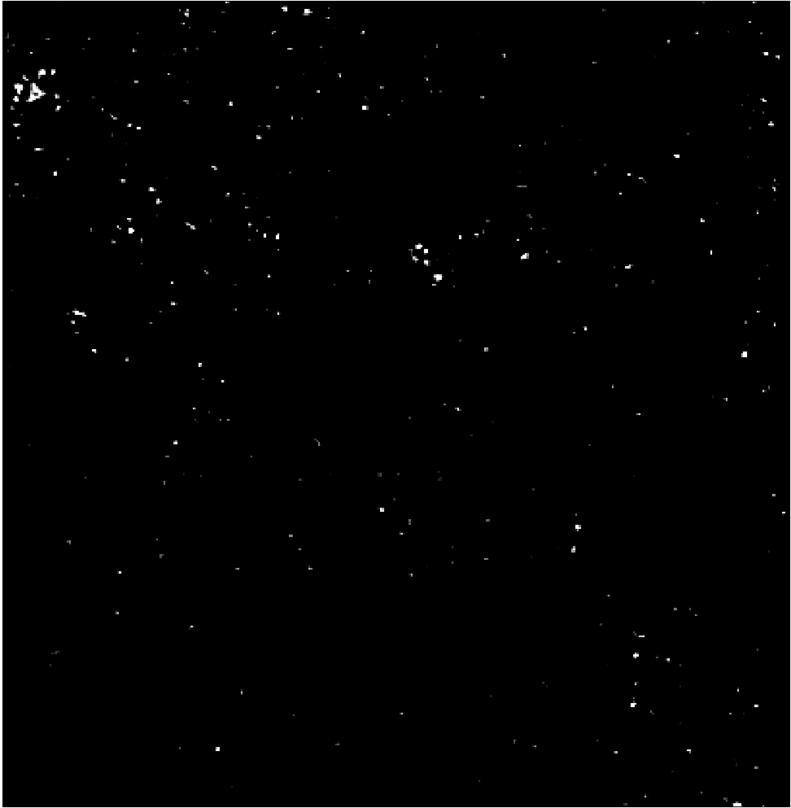
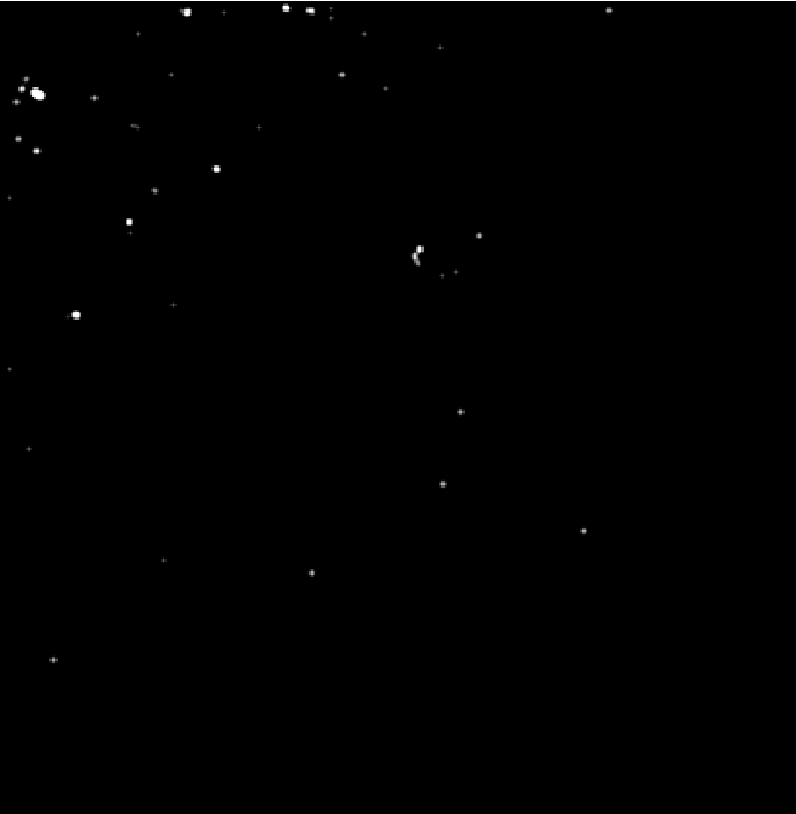
Cancerous plasma 745A mir-21 response
PANORAMA
Time: 60 min wash
Count: 277
Fluorescence (16%; 600±80)
Time: 60 wash min
Count: 45
Scale bar: 10 µm

Slide 8
Plasma samples mir-21 positive and negative
Mir-21 negative plasma samples
Healthy Plasma
HCR 83
HCR 153
HCR 154
HCR 155
HCR 156
HCR 157
HCR 158
Cancer Plasma
280A
830A
1021A

